Slide 1
Second Week – Day-to-Day Training
Company: TECHZENURE
Mentor: Ram Kumar

Slide 2
Name: Sirigiri Lohit Reddy
Employee Number:08
Position: SDE-I
Company: Techzenure

Slide 3
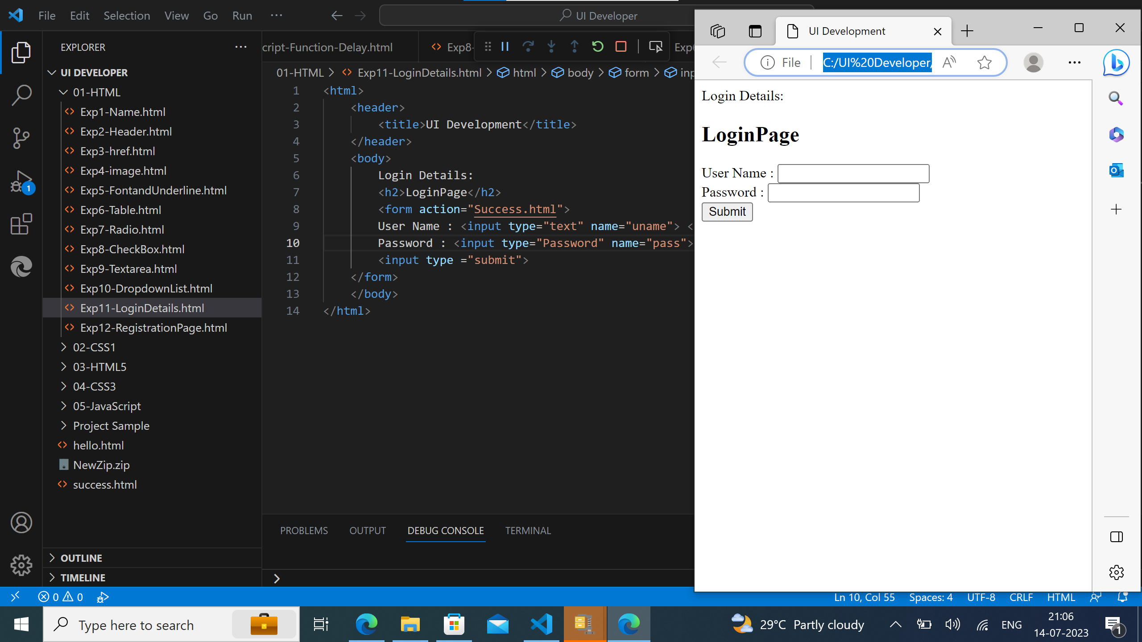
HTML Code for Login Page:

Slide 4
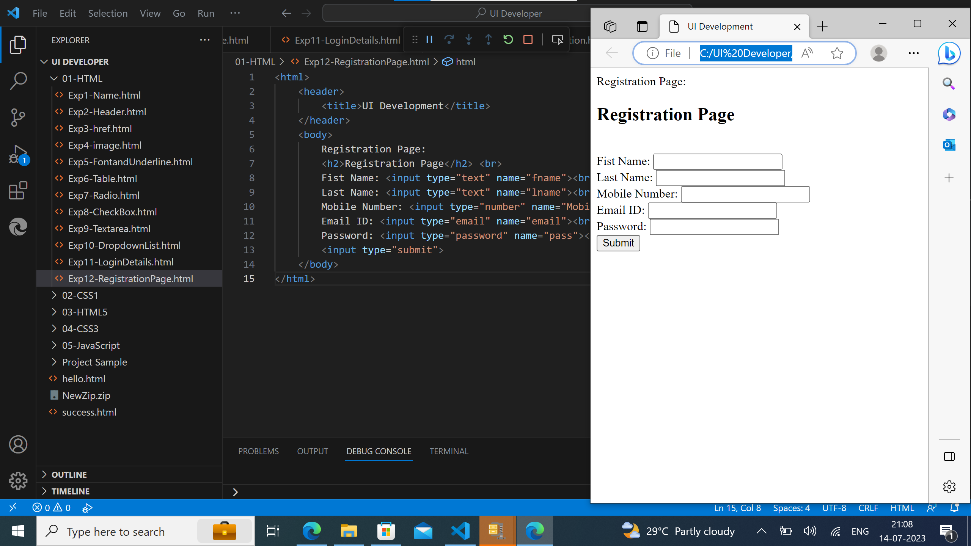
HTML Code for Registration Page:

Slide 5
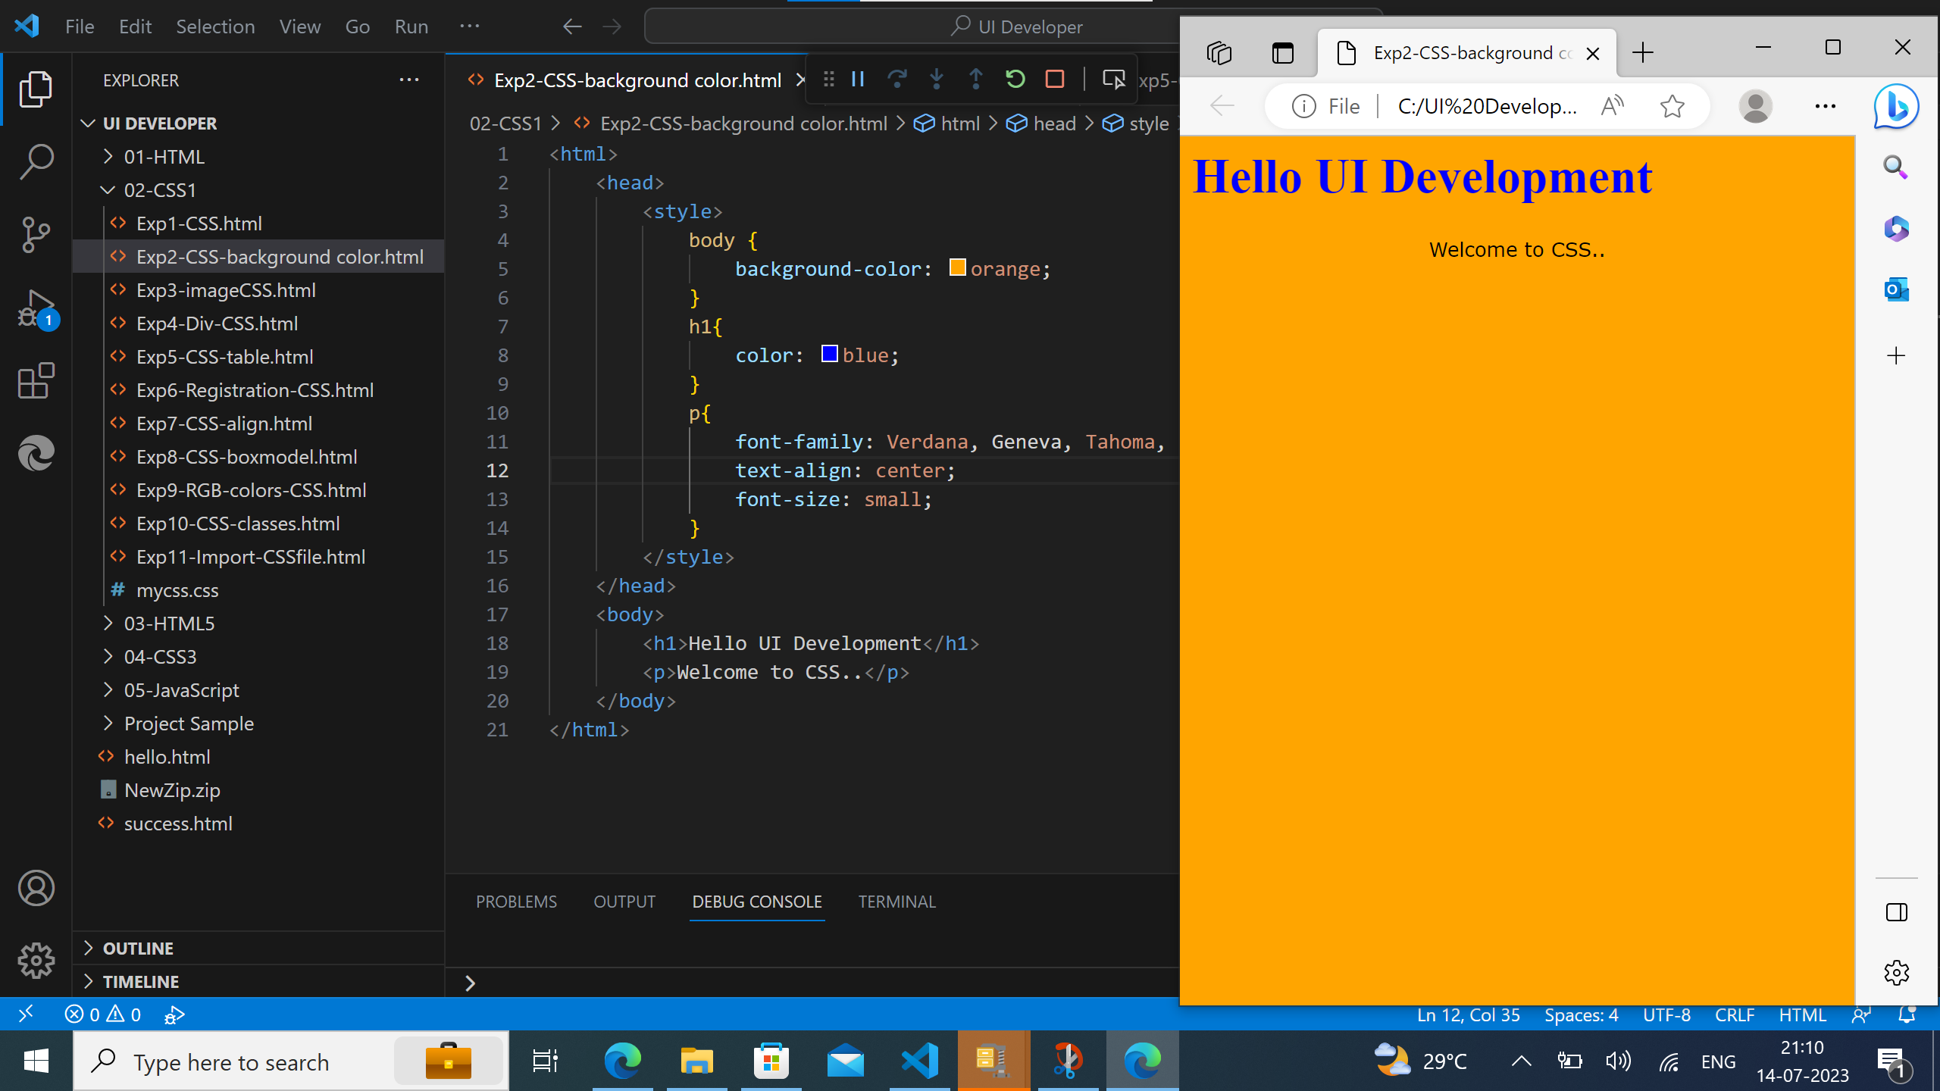
CSS Code for background colors:

Slide 6
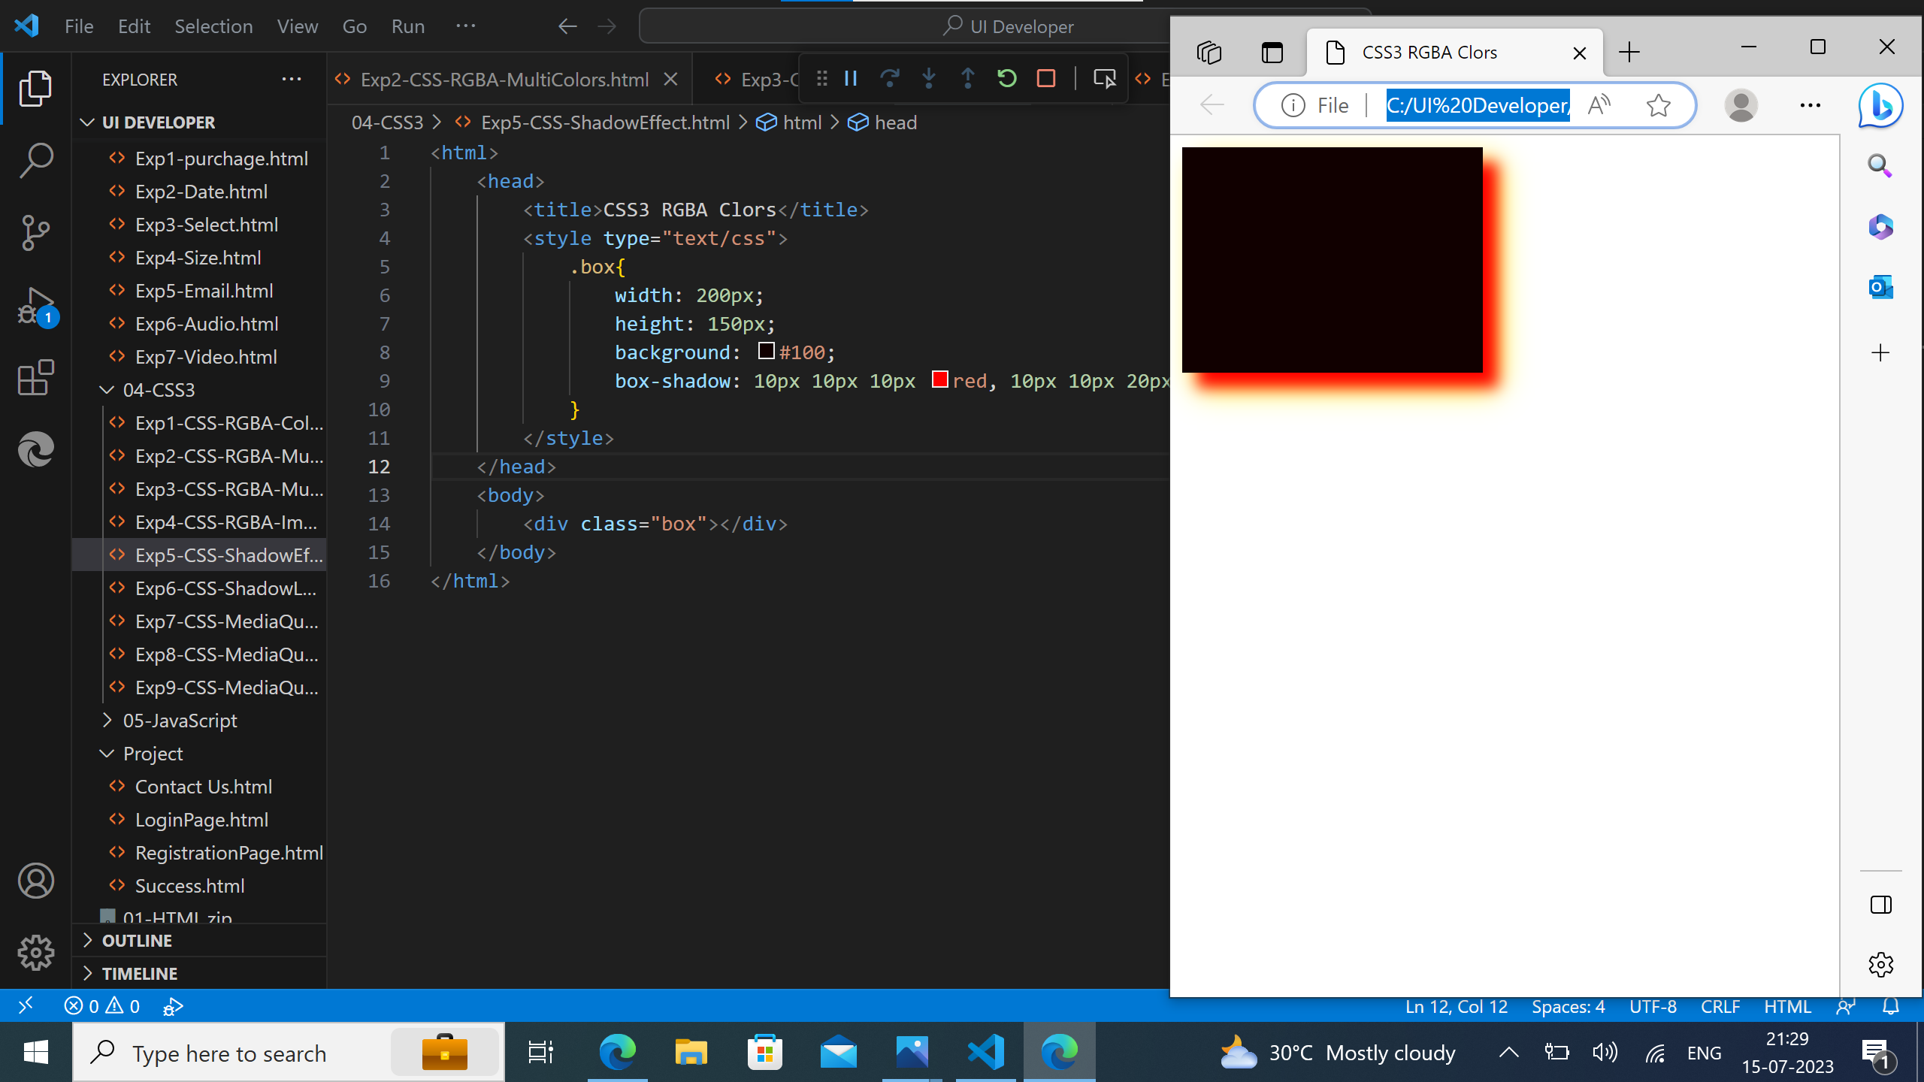
CSS Code for Shadow Effect:

Slide 7
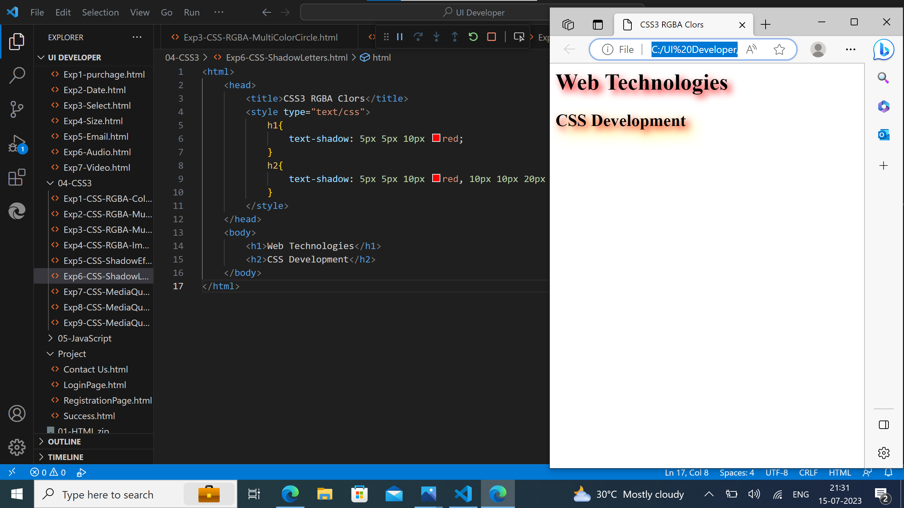
CSS Code for Shadow Letters :

Slide 8
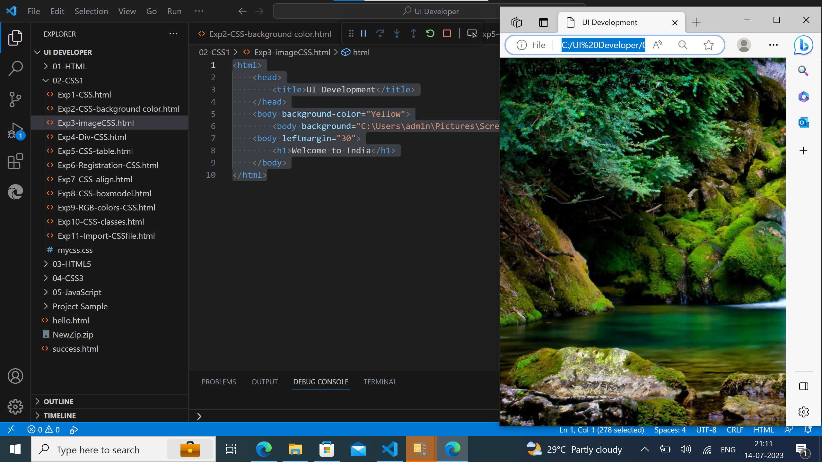
CSS Code for Image:

Slide 9
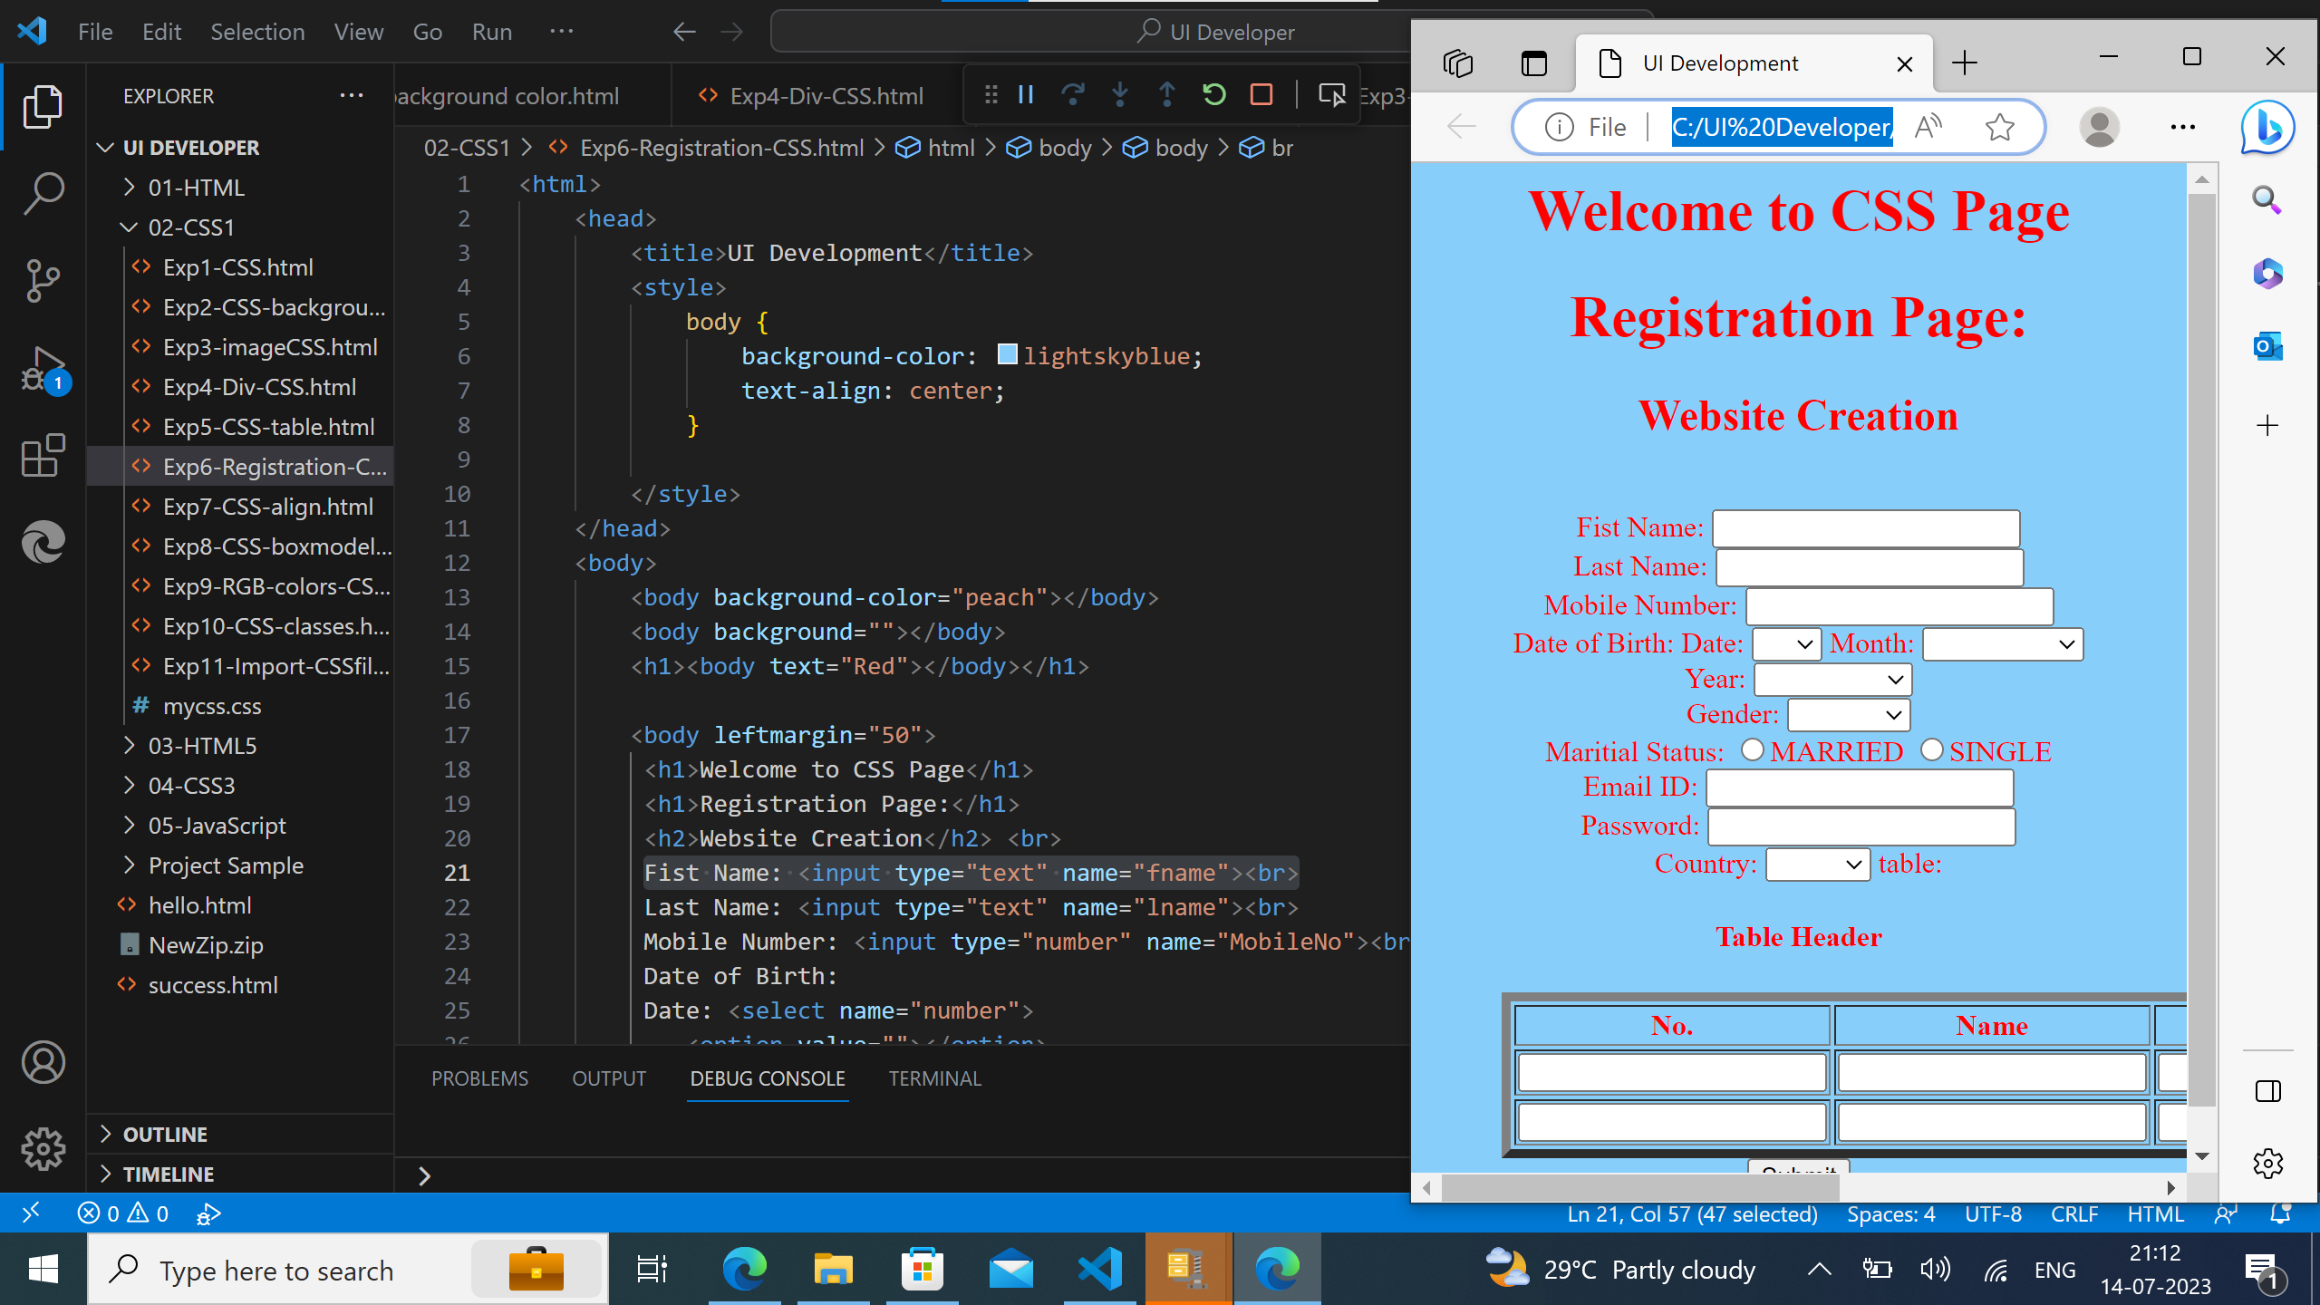
CSS Code for Registration Page:

Slide 10
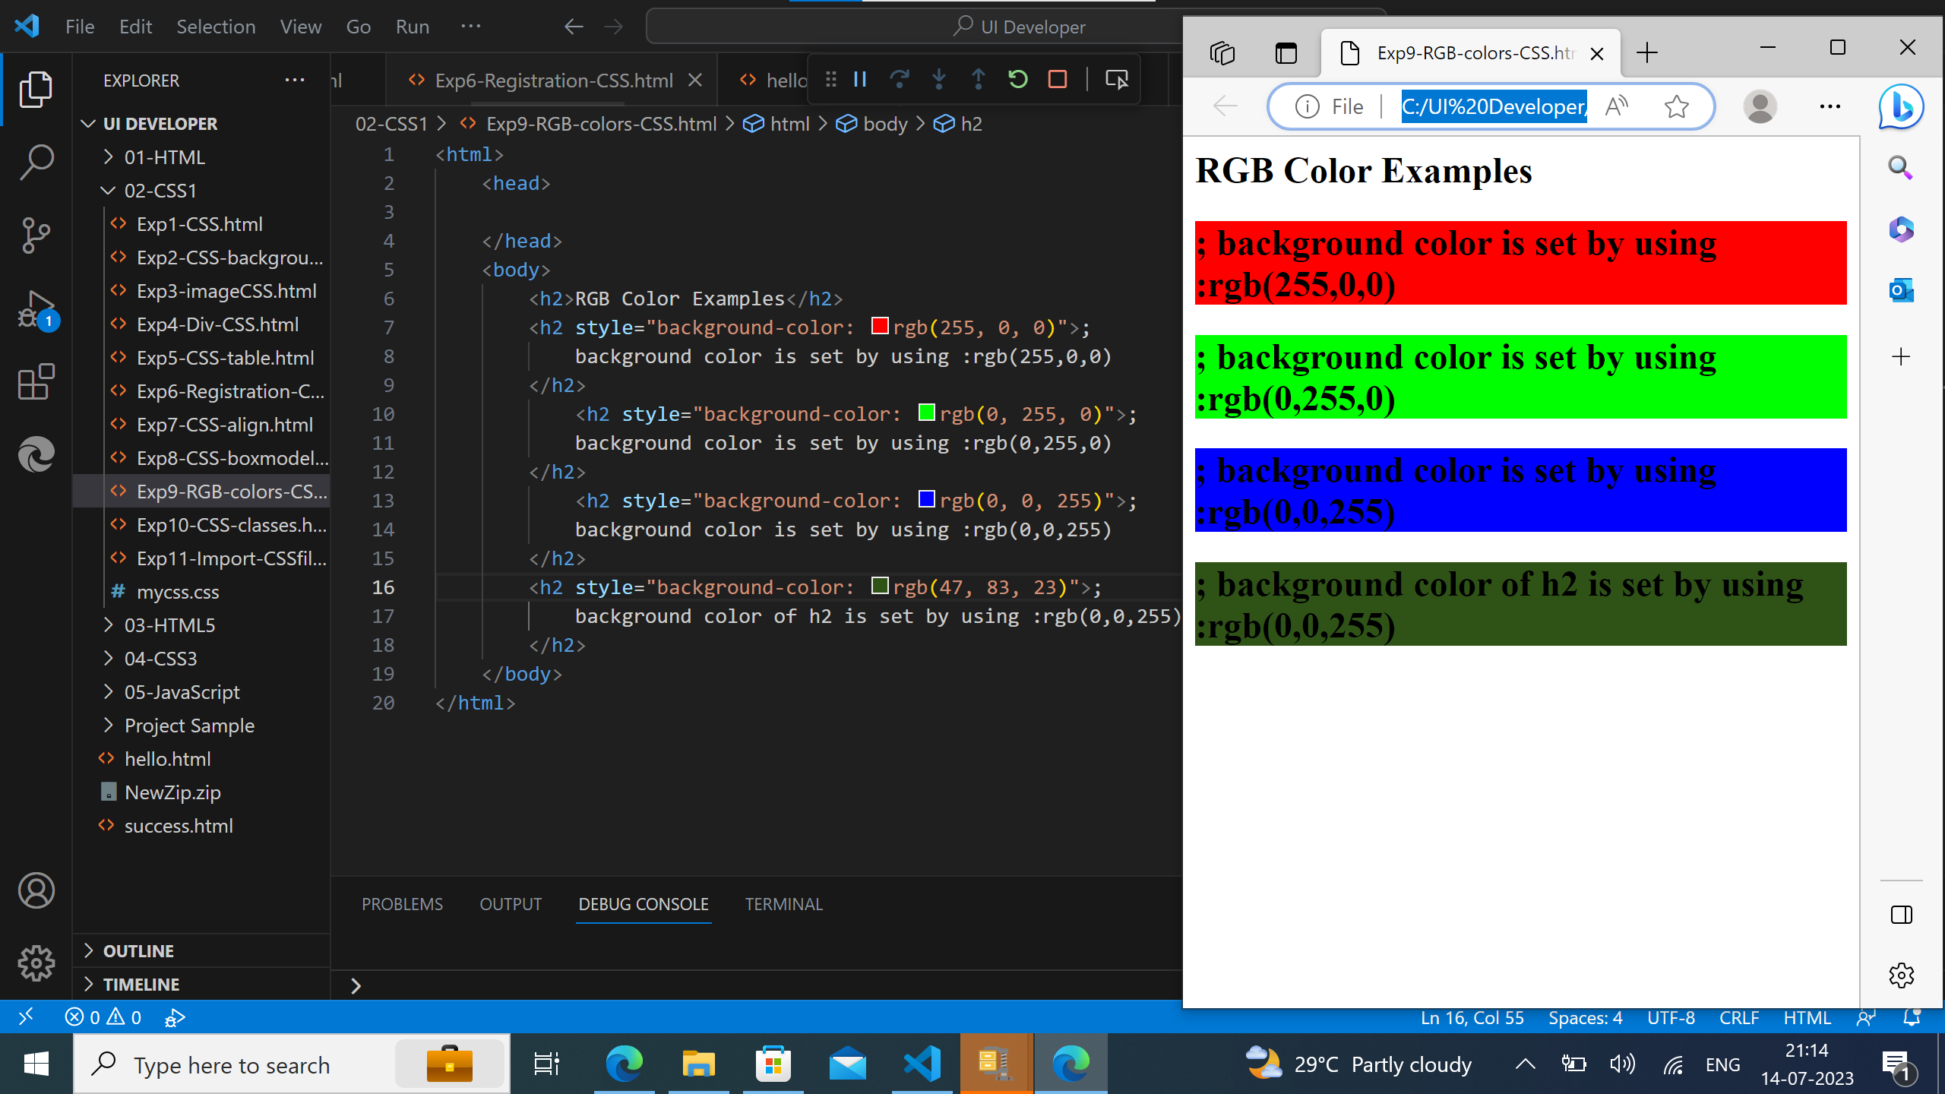
CSS Code for RGB colors:

Slide 11
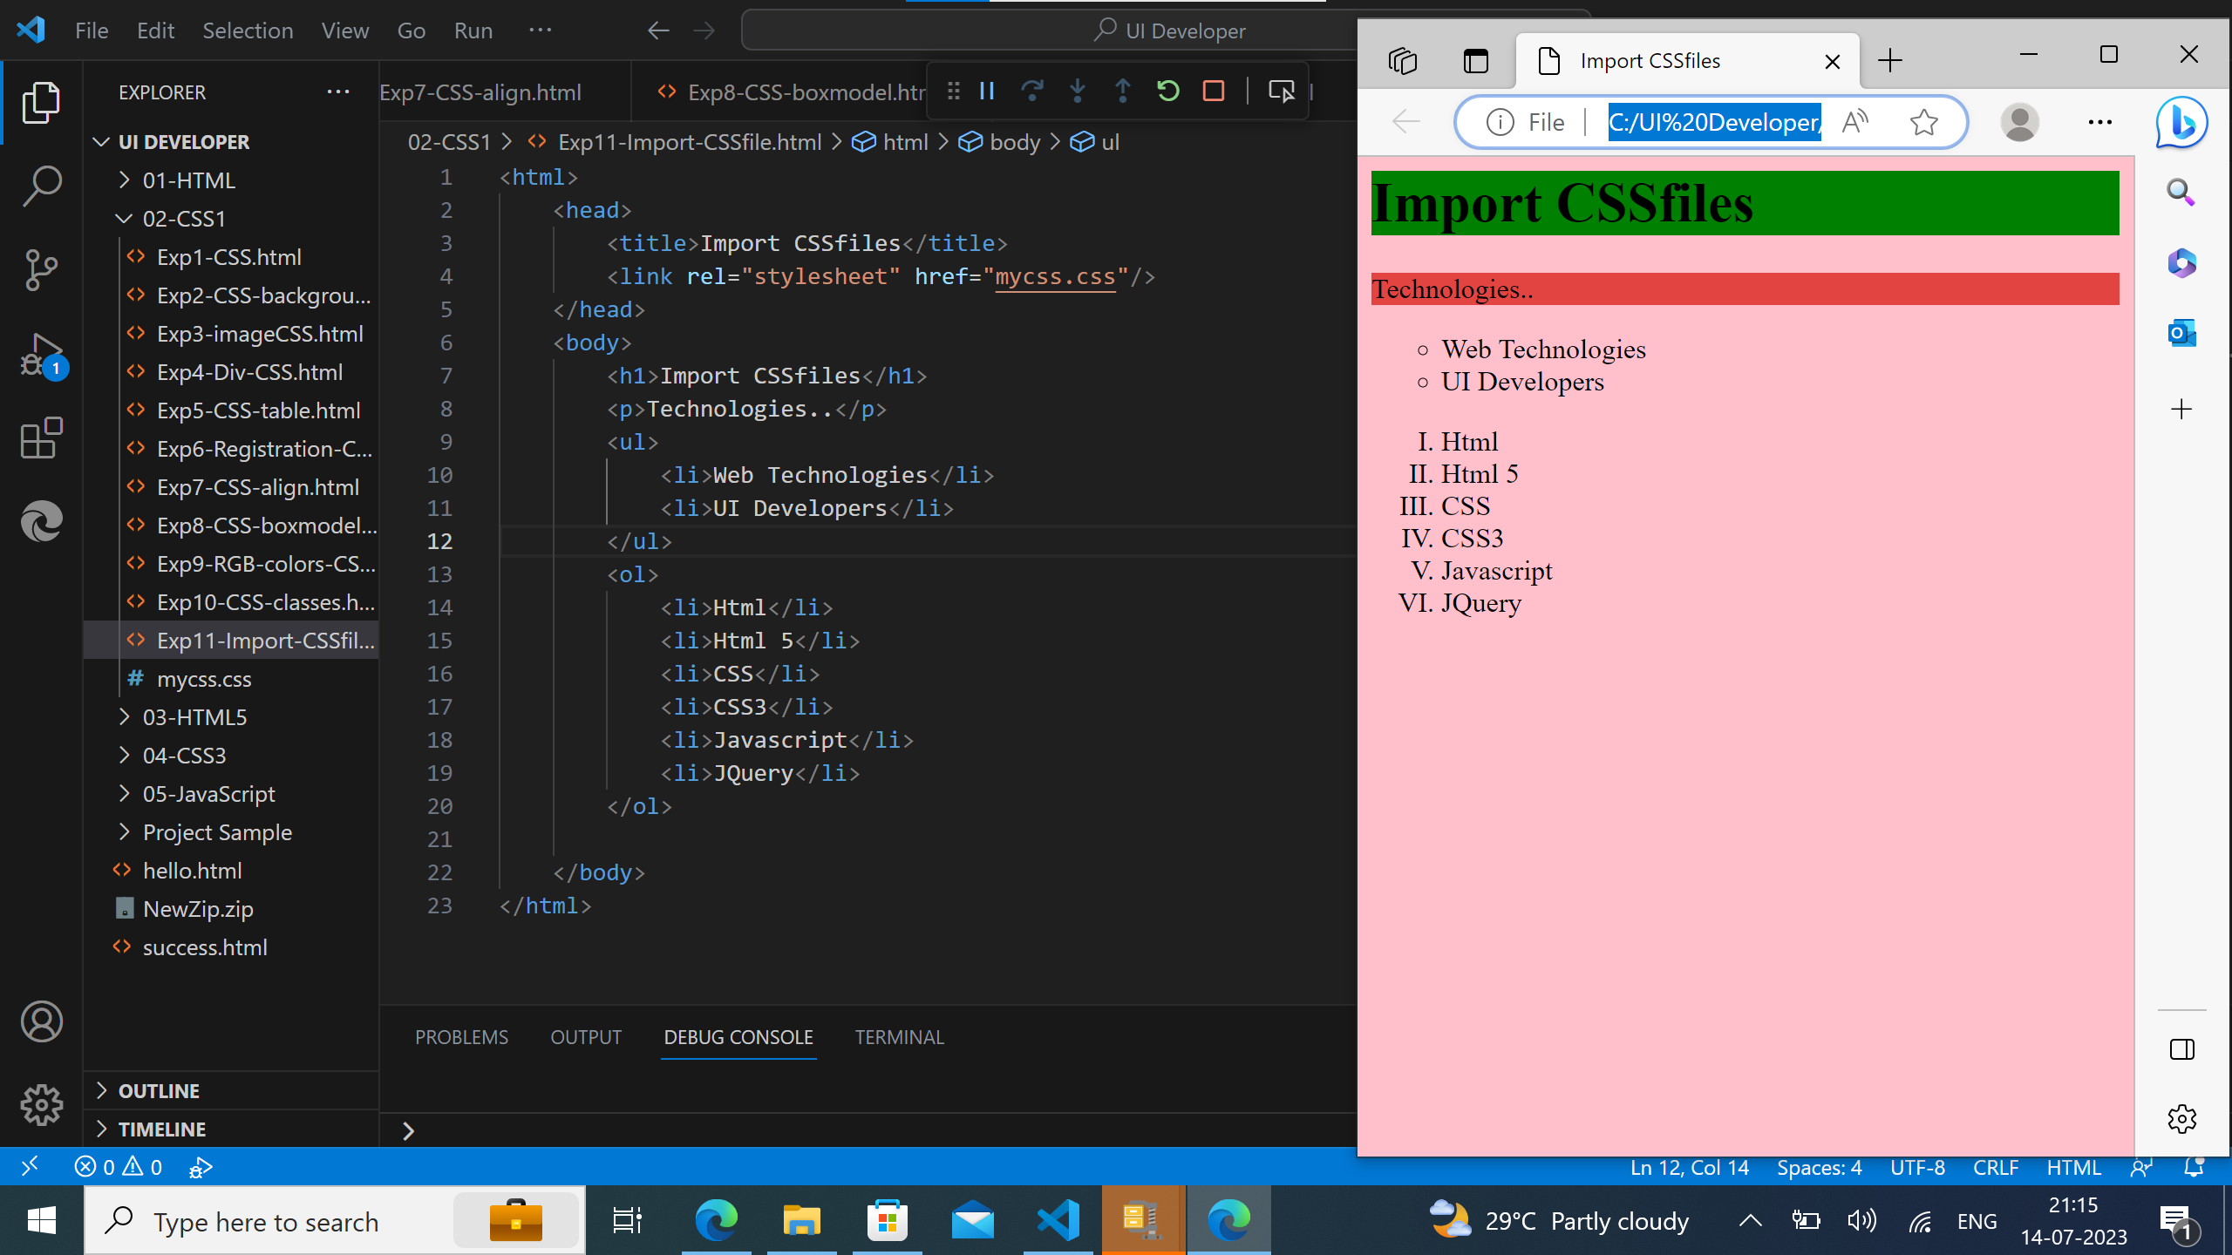
CSS Code for file import:

Slide 12
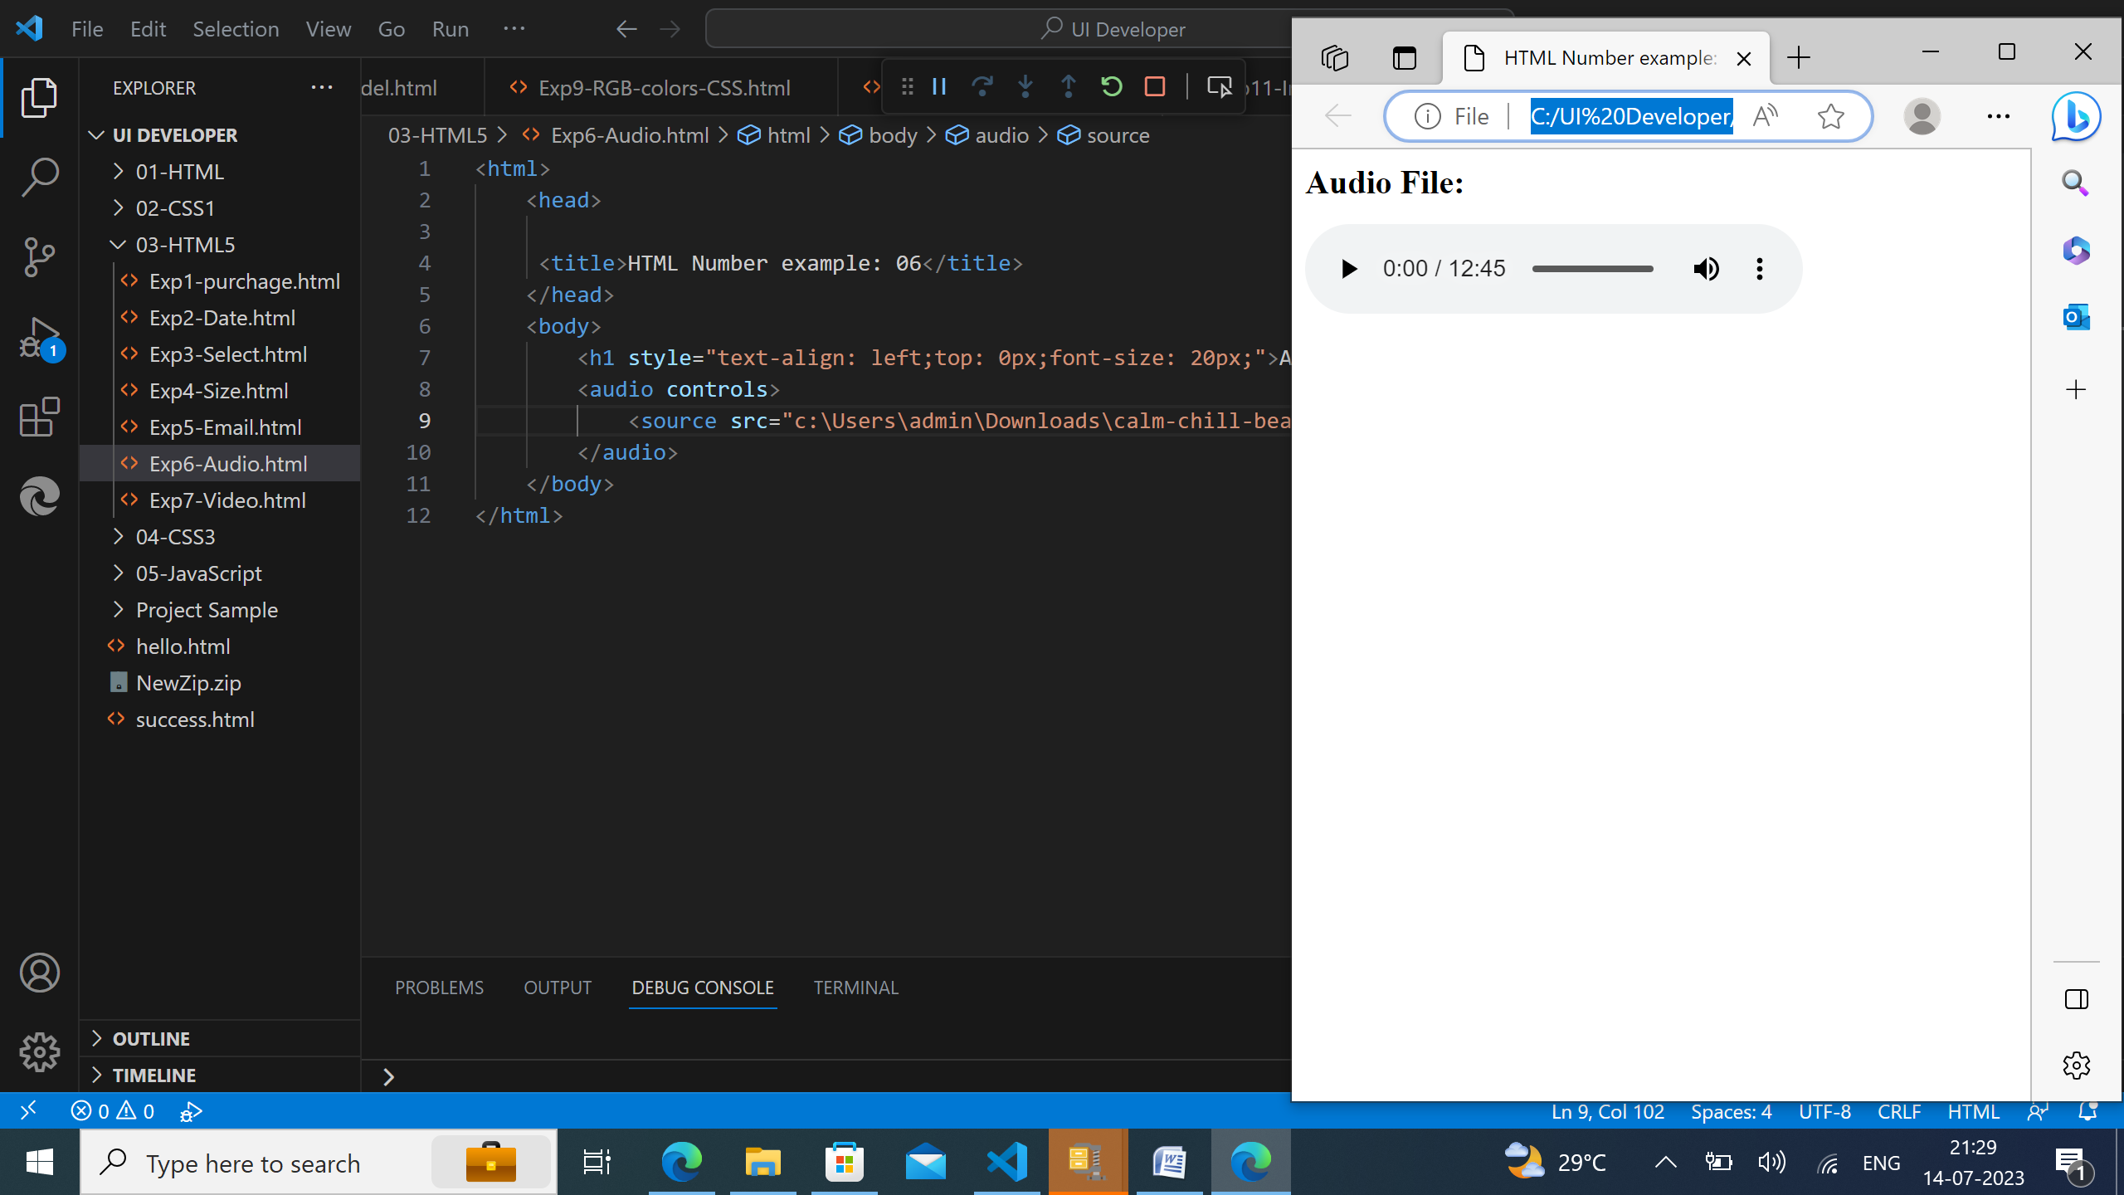
HTML5 Code for Audio:

Slide 13
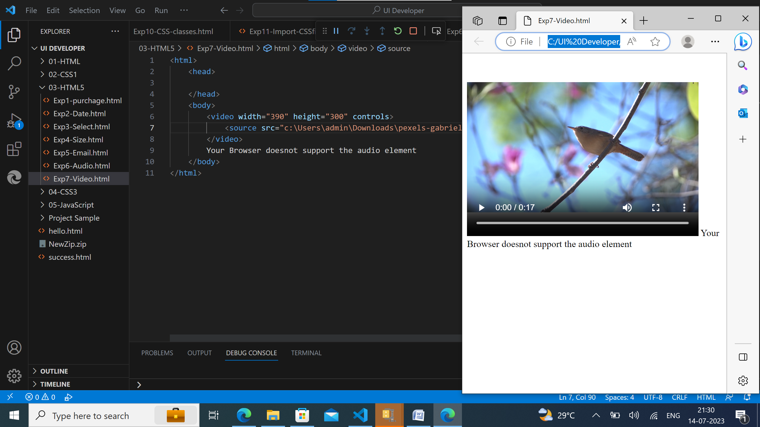
HTML5 Code for Video:

Slide 14
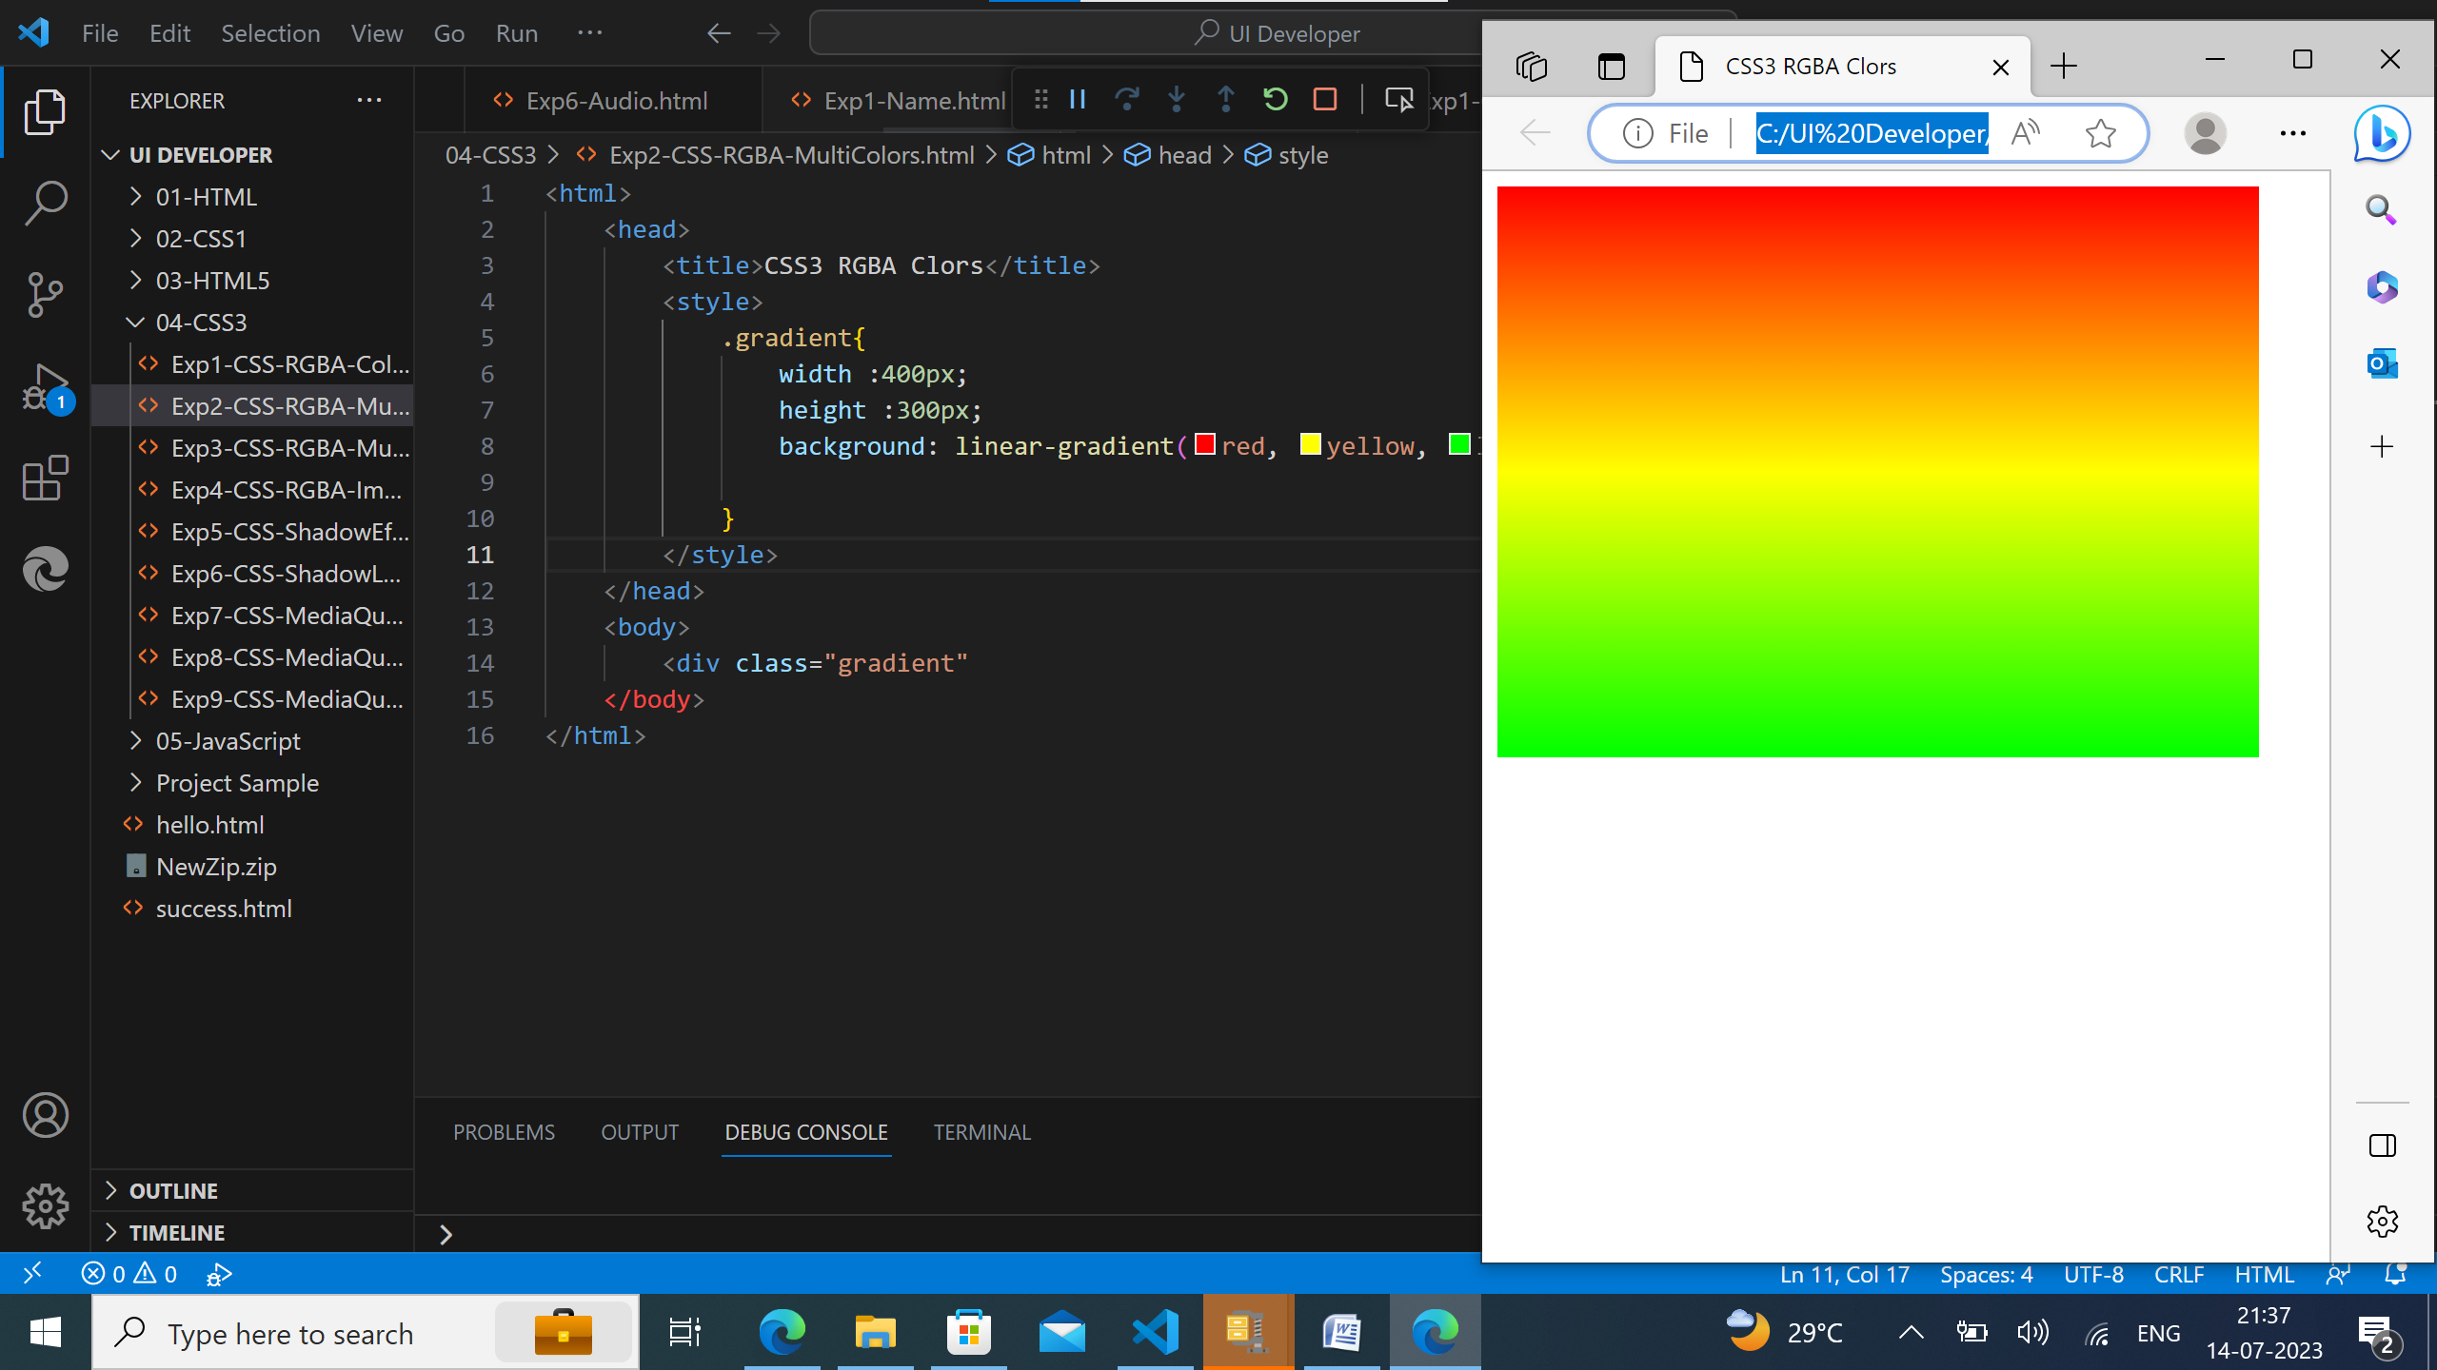
CSS3 Code for RGBA Multi Colors:

Slide 15
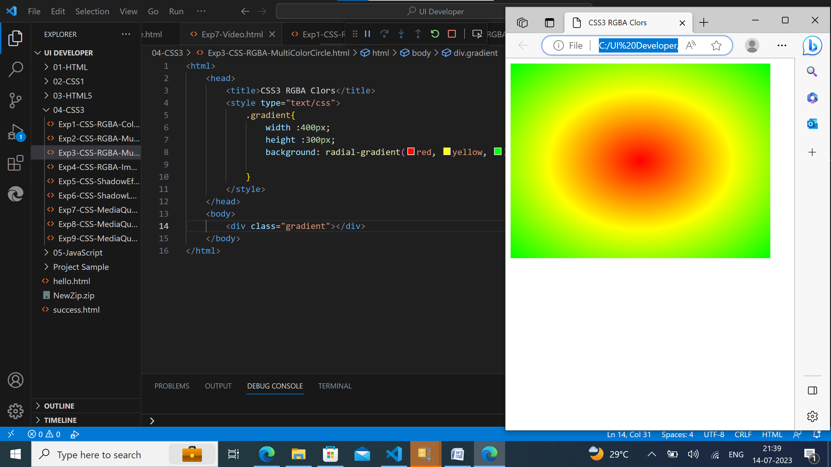
CSS3 Code for RGBA Multi Color Circle:

Slide 16
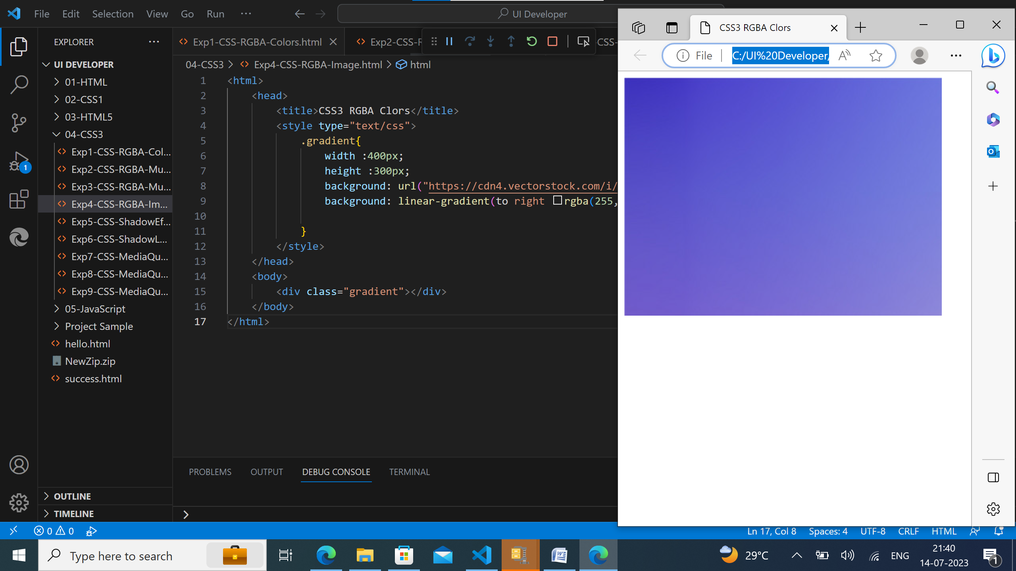
CSS3 Code for RGBA Image:

Slide 17
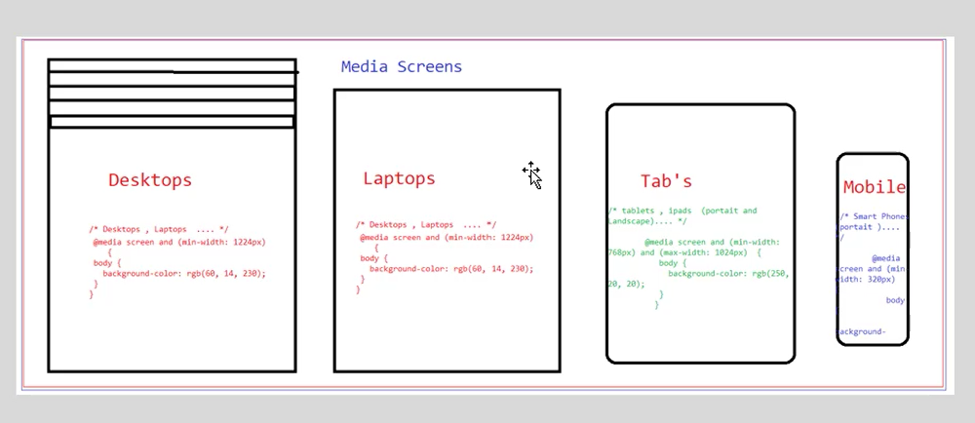
Media Queries Architecture:

Slide 18
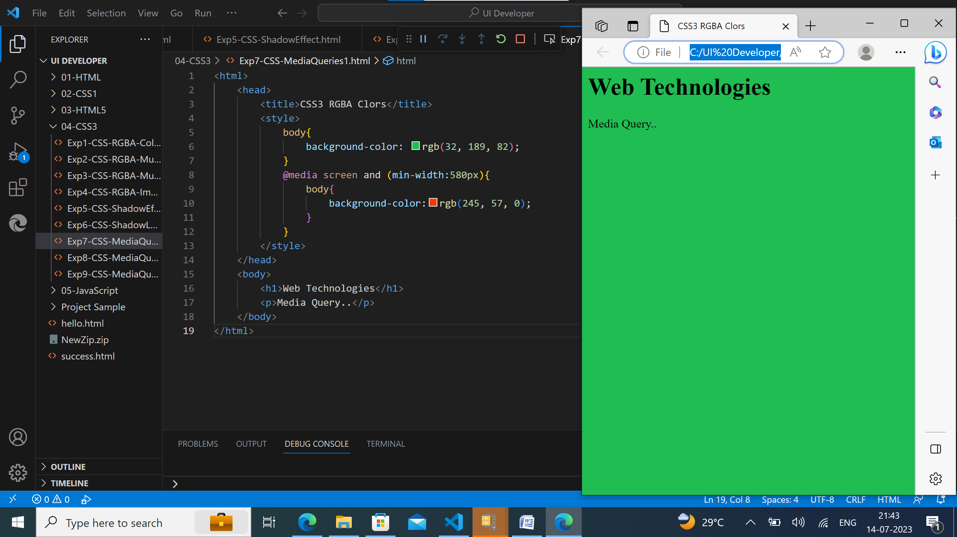
CSS3 Code for Media Queries1:

Slide 19
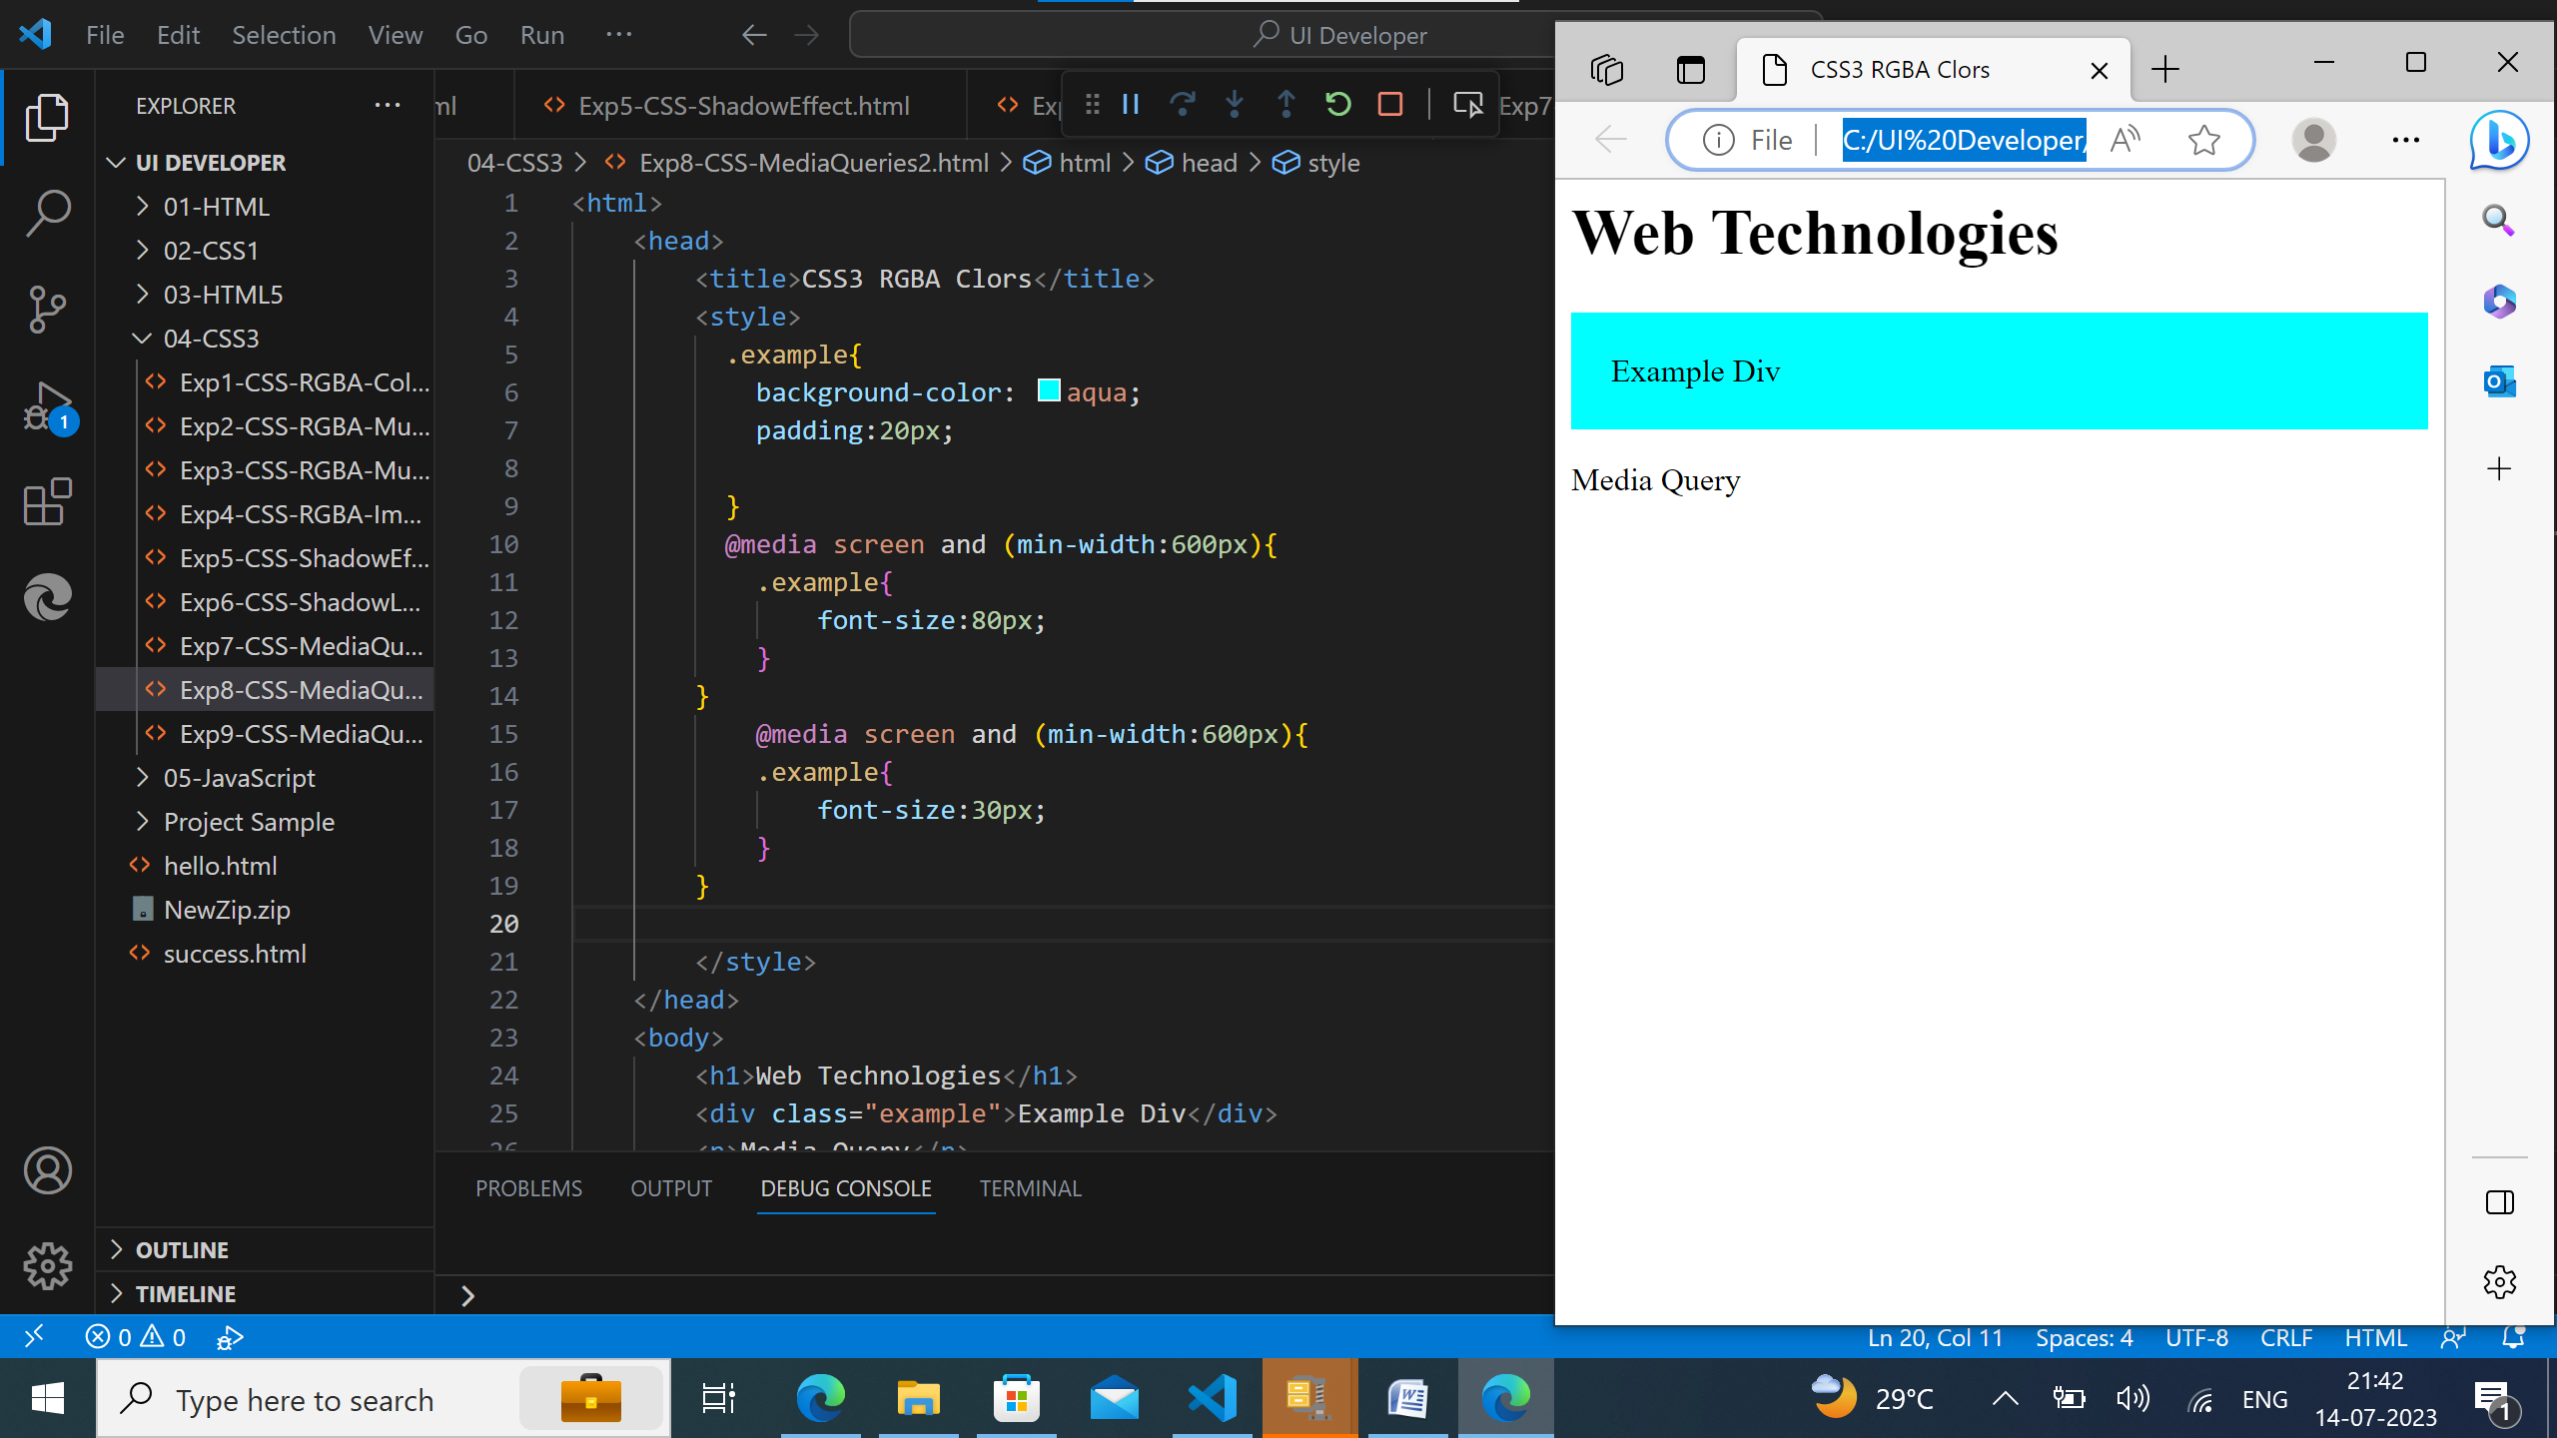
CSS3 Code for Media Queries2:

Slide 20
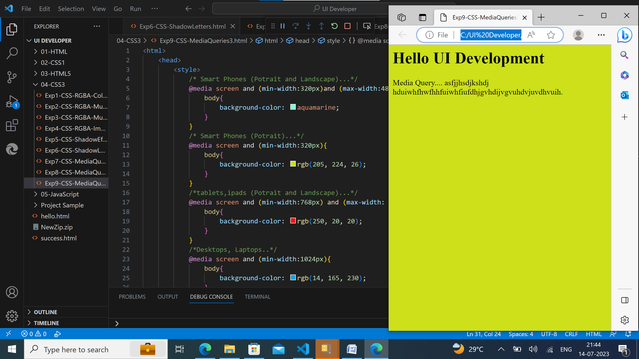
CSS3 Code for Media Queries3:

Slide 21
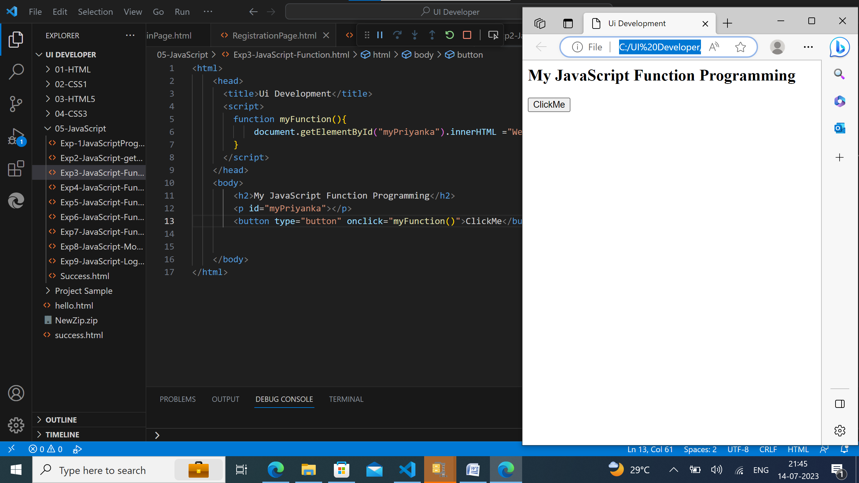
JavaSript Function:

Slide 22
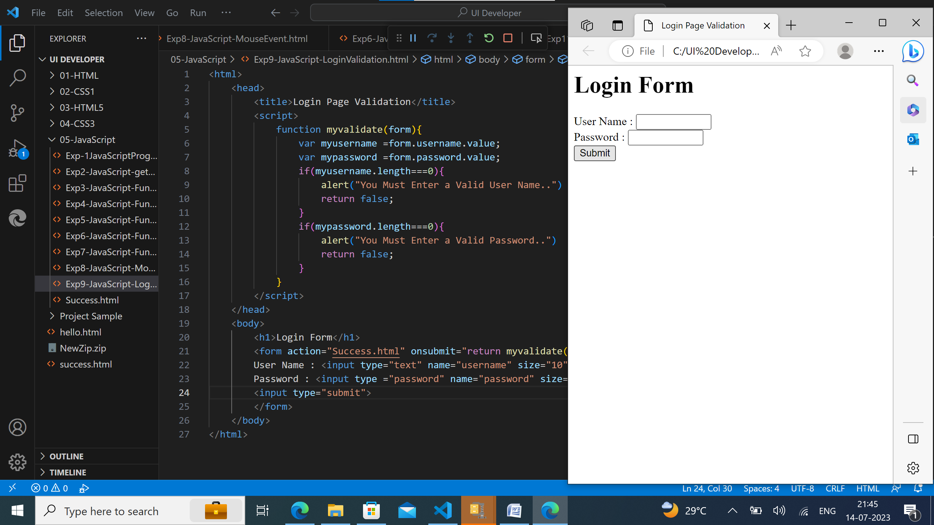
JavaSript Login Page: 1st Output:

Slide 23
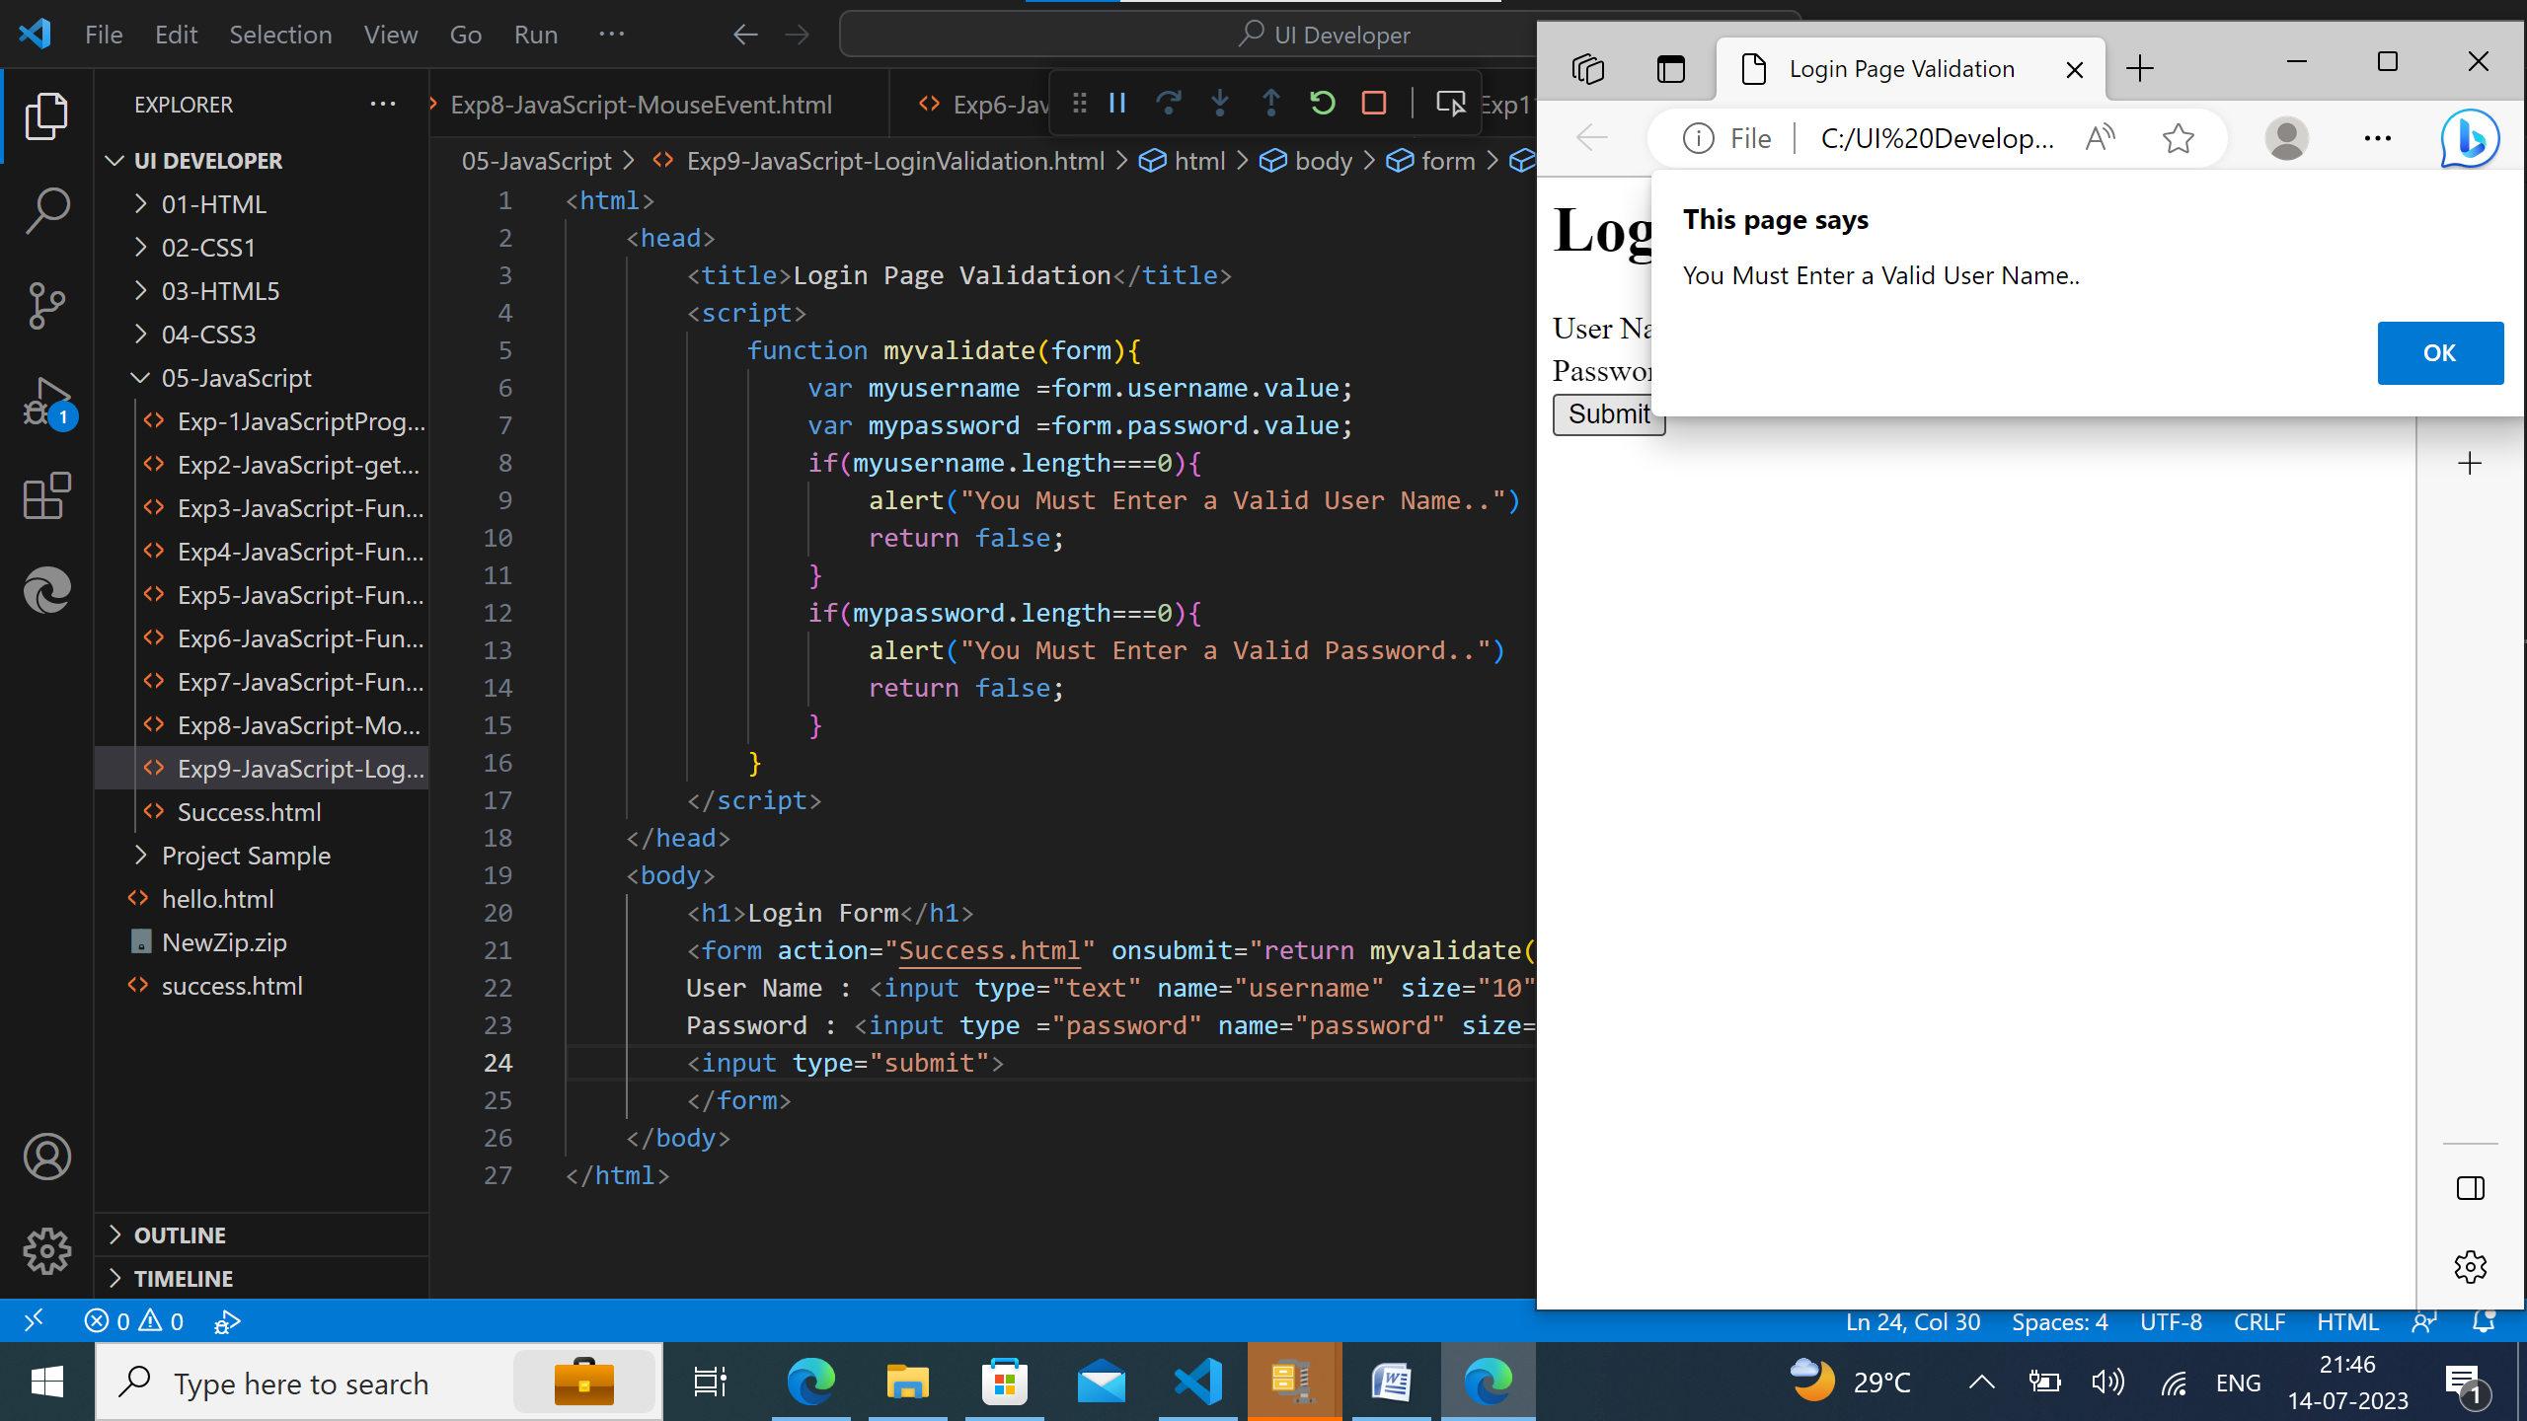
JavaSript Login Page: 2nd Output:

Slide 24
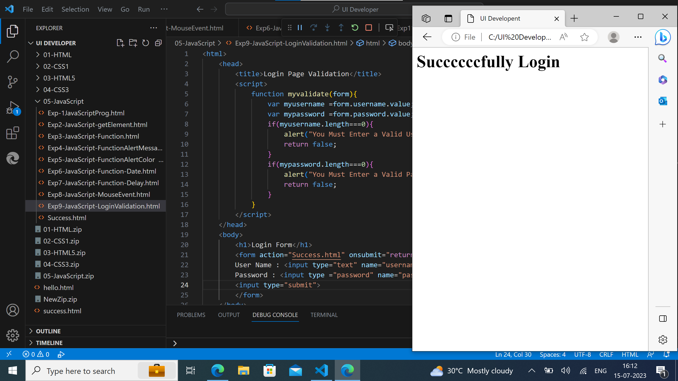
JavaSript Login Page: 3rd Output:

Slide 25
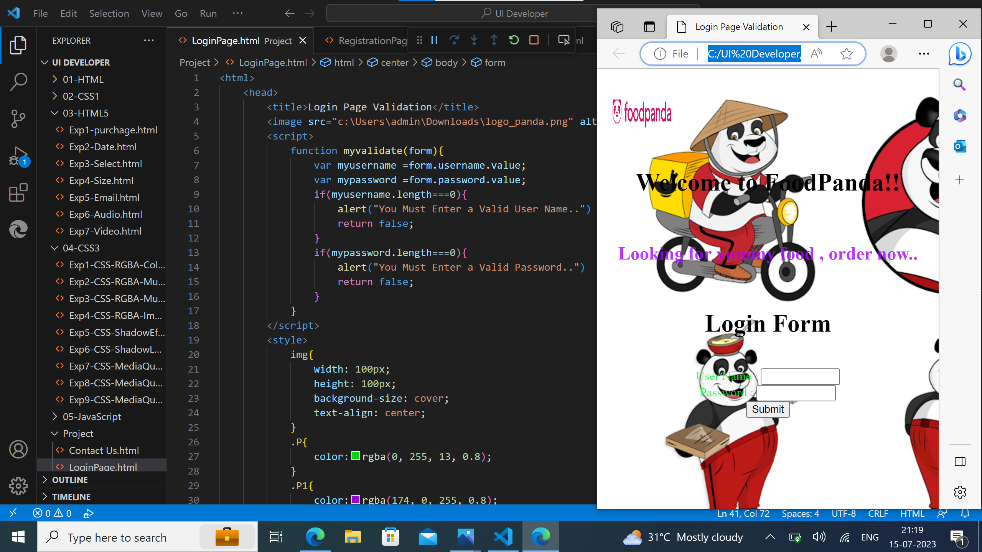
Task on Creating of Login page using Javascript, CSS and HTML:

Slide 26
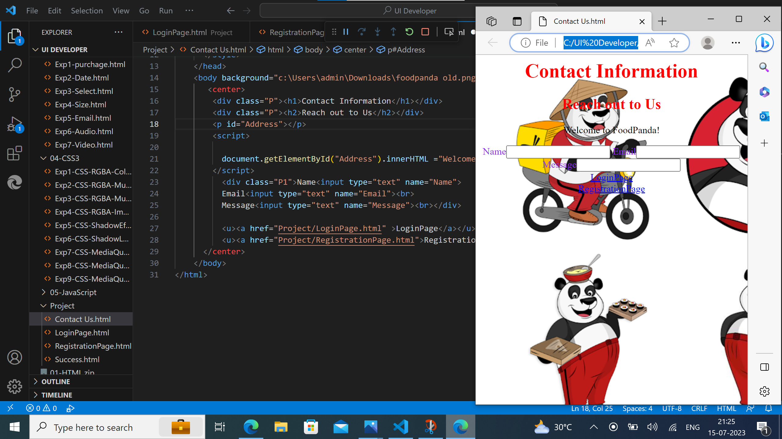
Task on Creating of Contact Us page using Javascript, CSS and HTML:

Slide 27

Thank you

